Slide 1
Metro STEMI Task Force The Central Iowa EMS Directors STEMI Task Force is striving to improve the patient outcomes of ST elevation myocardial infarctions. Current members Central Iowa EMS Directors Association Broadlawns Medical Center Mercy Hospital Medical Center Mercy West Lakes Unity Point Health (Methodist, Lutheran and West) Iowa Heart Center UnityPoint Health Cardiology Iowa Clinic Cardiology

Slide 2
STEMI Task Force Goals
Goals for 2016
Establish/improve a method for data collection that includes
pre- hospital data and feedback
Established standardized pre-hospital protocols for STEMI including
12 lead ECG transmission
Monitor and improve outcomes such as door to balloon, first
medical contact to balloon, etc…
Develop improved education for EMS providers, nursing and physicians
Increase medical director involvement in pre-hospital STEMI care
Provide public education to improve recognition and
appropriate actions

Slide 3
Metro STEMI Task Force
2016 Task Force Initiatives
Implement STEMI Kit protocol
Continue emphasis on STEMI Tag completion
Develop strategic plan for Community Education in order to further decrease time of symptom onset to Balloon

Slide 4
STEMI Task Force Data Points
Time of symptom onset
Dispatch time from communications center
Time of 1st medical contact
Time of 1st ECG
Scene times and details may be added

Slide 5
STEMI ALERT?????
Don’t forget your TAG
Tags now included in your STEMI Kit!
Kits provided by Emergency Dept. at IMMC, ILH, Mercy Downtown,
Mercy West Lakes

Slide 6
STEMI Kit for EMS
The STEMI Kit includes
Pt. belonging bag
STEMI Tag
Pt. gown
Each ambulance should pick up initial kit from one of the following Emergency Depts.
IMMC, ILH, Mercy Downtown, Mercy West Lakes, When dropping off your STEMI Pt., pick up a replacement kit for your ambulance
If time permits, All STEMI Patients should be fully undressed, placed in patient gown. At a minimum, STEMI Tag should be initiated.
STEMI Kit Pilot project was very successful in reducing time to balloon

Slide 7
STEMI Task Force Data Tag

Slide 8
Back side of Tag
Reminder
Provide copy of your 12 lead
Label 12 lead with Pt. name and age
Complete and leave tag on Pt. or with nurse
Go to CIEMSD website to request Patient follow up
http://www.ciemsd.org/?page_id=518
(password: ems)
For more information on
Metro STEMI Task Force contact
admin@ciemsd.org

Slide 9
STEMI Alert activation procedure
Request STEMI Alert to ED if:
i. 12 lead interpretation by Paramedic
ii. Acute MI/STEMI Alert diagnosis by monitor
(No physician contact required)
b. Provide the following information:
i. Patient report including patient condition, assessment findings, ECG analysis,
ii. name and DOB, ETA
c. Provide copy of 12 lead and report to hospital

Slide 10
STEMI Task Force Data Tag
EMS is to initiate use of STEMI Kit and complete STEMI Data Tag for each STEMI patient.
(not all chest pain Patients –just STEMI patients)

Slide 11
STEMI Task Force Data Tag
IF tag is incomplete or
missing…… ED or Cath Lab
staff must complete tag by collecting times before EMS leaves the Hospital.

Slide 12
STEMI Task Force Data Tag Project has been active since Aug. 1, 2014
2015 data
185 STEMI alerts were initiated at DM metro hospitals by EMS
86 tags were utilized by EMS for a 46% compliance rate
Increased compliance in 2016 is anticipated by initiating the STEMI Kit program
For complete STEMI data results –see www.CIEMSD.org

Slide 13
STEMI Task Force Data Tag
At hospital, completed Tag must be labeled with patient identifier to enable placement into medical record.
Details of this process will be defined by each participating health system

Slide 14
Please make sure your Medical Director and EMS crews are well informed on this project It is the goal that the Kit be utilized and tag be completed on ALL STEMI patients
STEMI Task Force Data Tag

Slide 15
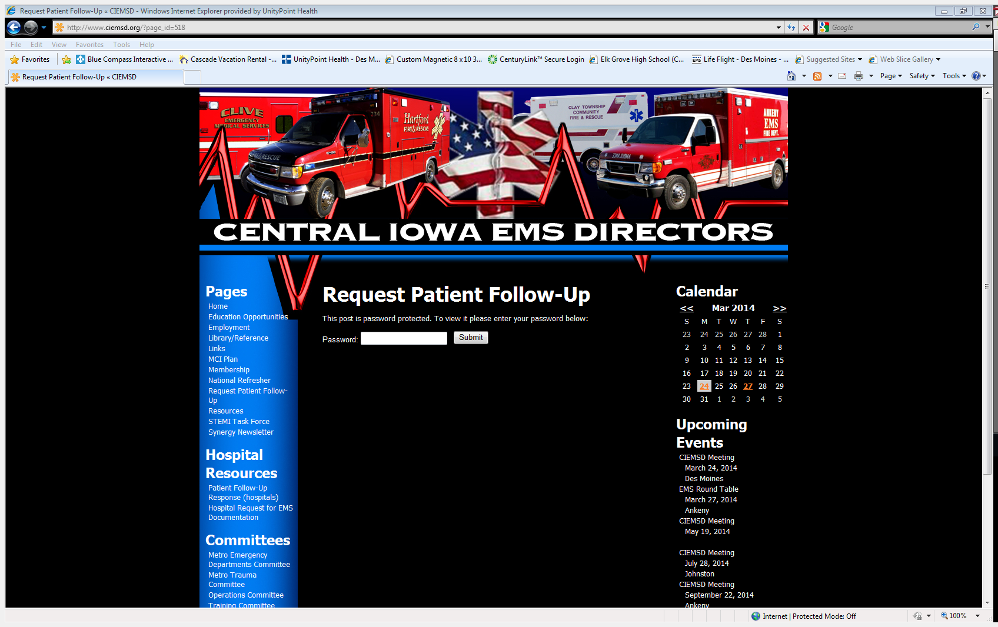
Pt. follow up is always available. www.ciemsd.org

Slide 16
Metro STEMI Task Force
For further information regarding this education or content please contact:
Katy Hill RN, BSN, CFRN, EMT-B
EMS Coordinator UnityPoint Health Des Monies
(515) 241-6747 office
katherine.hill@unitypoint.org

